Slide 1


Xcode Career Service
关注 Xcode 即可获得热腾腾的高频题解析视频、面试技巧及准备tips、北美IT就业咨询等干货
一对一实习或工作信息咨询服务
一对一面试能力评定 + 修改简历
一对一Mock interview强化训练服务

Slide 2
想进 xcode 的刷题群，请加老师微信 singerdmx， 他会拉你进群

Slide 3

Segment Tree 专题

Slide 4
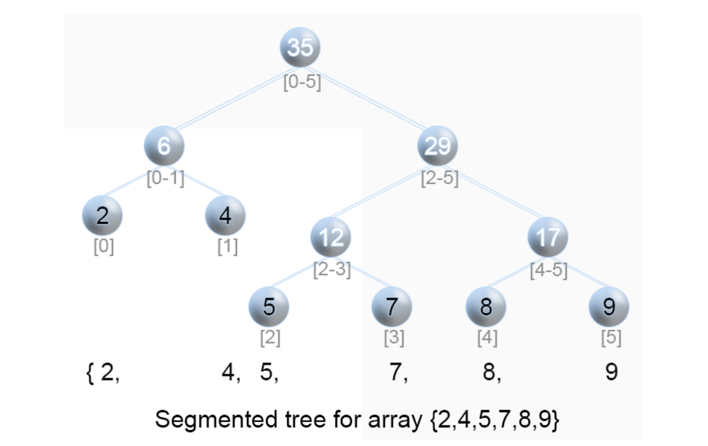

Slide 5
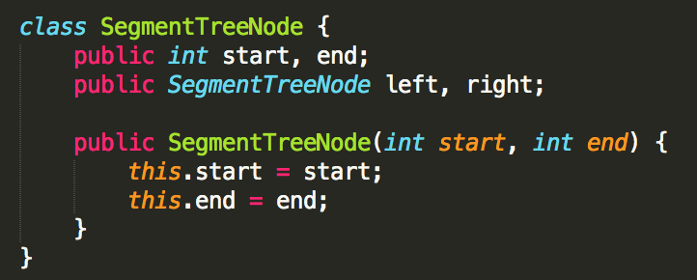
Segment Tree
The structure of Segment Tree is a binary tree which each node has two attributes start and end denote an segment / interval

Slide 6
The left child of node A
start = A.left
end = (A.left + A.right) / 2
The right child of node A
start = (A.left + A.right) / 2 + 1
end = A.right
If start equals to end, there will be no children for this node

Slide 7
Given start = 0, end = 3
[0, 3]
[0, 1]
[2, 3]
[0, 0]
[1, 1]
[2, 2]
[3, 3]

Slide 8
Given start = 1, end = 6
[1, 6]
[1, 3]
[4, 6]
[1, 2]
[3, 3]
[4, 5]
[6, 6]
[1, 1]
[2, 2]
[4, 4]
[5, 5]

Slide 9
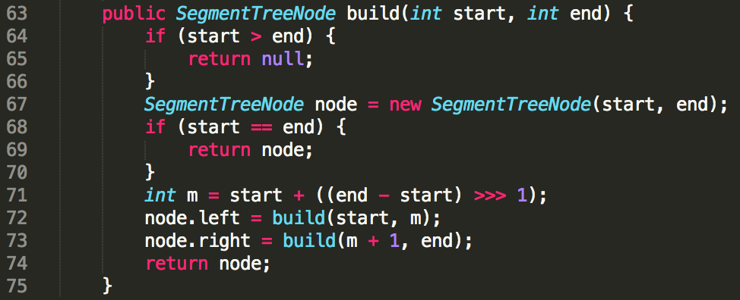

Slide 10
Runtime: O(n)
[0, 3]
n/4
[0, 1]
[2, 3]
n/2
[0, 0]
[1, 1]
[2, 2]
[3, 3]
n
n + n/2 + n/4 + … + 1 = 2n

Slide 11
Space: O(n)
[0, 3]
n/4
[0, 1]
[2, 3]
n/2
[0, 0]
[1, 1]
[2, 2]
[3, 3]
n
n + n/2 + n/4 + … + 1 = 2n

Slide 12
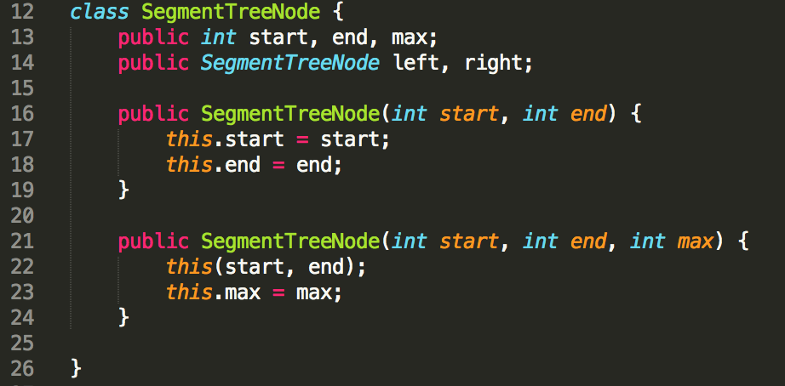
Segment tree with every node value
represent the corresponding interval max value in the array

Slide 13
Given [3, 2, 1, 4]
[0, 3] (max = 4)
[0, 1] (max = 3)
[2, 3] (max = 4)
[0, 0] (max = 3)
[1, 1] (max = 2)
[2, 2] (max = 1)
[3, 3] (max = 4)

Slide 14
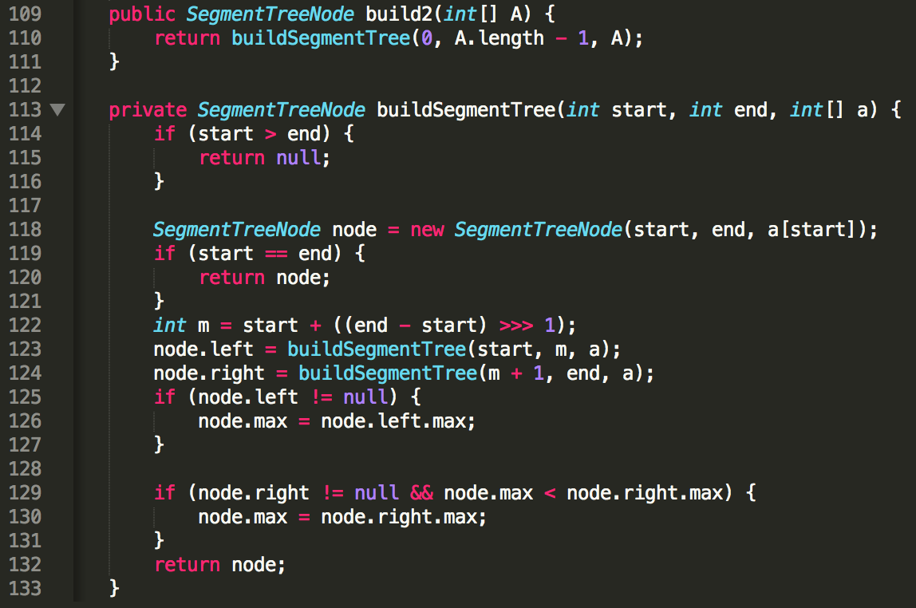

Slide 15
Given [3, 2, 1, 4]
[0, 3] (max = 4)
[0, 1] (max = 3)
[2, 3] (max = 4)
[0, 0] (max = 3)
[1, 1] (max = 2)
[2, 2] (max = 1)
[3, 3] (max = 4)
query(root, 1, 1), return 2

Slide 16
Given [3, 2, 1, 4]
[0, 3] (max = 4)
[0, 1] (max = 3)
[2, 3] (max = 4)
[0, 0] (max = 3)
[1, 1] (max = 2)
[2, 2] (max = 1)
[3, 3] (max = 4)
query(root, 1, 2), return 2

Slide 17
Given [3, 2, 1, 4]
[0, 3] (max = 4)
[0, 1] (max = 3)
[2, 3] (max = 4)
[0, 0] (max = 3)
[1, 1] (max = 2)
[2, 2] (max = 1)
[3, 3] (max = 4)
query(root, 2, 3), return 4

Slide 18
Given [3, 2, 1, 4]
[0, 3] (max = 4)
[0, 1] (max = 3)
[2, 3] (max = 4)
[0, 0] (max = 3)
[1, 1] (max = 2)
[2, 2] (max = 1)
[3, 3] (max = 4)
query(root, 0, 2), return 3

Slide 19
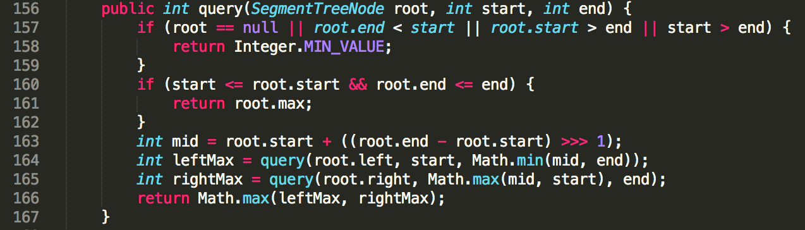

Slide 20
[root.start, root.end]
start
root
end
root
[root.start, root.end]
start
end
left
right
mid

Slide 21
root
[root.start, root.end]
start
end
left
right
mid

Slide 22
root
[root.start, root.end]
start
end
left
right
mid

Slide 23
Given [3, 2, 1, 4]
[0, 3] (max = 4)
[0, 1] (max = 3)
[2, 3] (max = 4)
[0, 0] (max = 3)
[1, 1] (max = 2)
[2, 2] (max = 1)
[3, 3] (max = 4)
start: 0
end: 2
mid: 1
left: [0, 1]
right: [2, 2]

Slide 24
Given [3, 2, 1, 4]
[0, 3] (max = 4)
3
[0, 1] (max = 3)
[2, 3] (max = 4)
[0, 0] (max = 3)
[1, 1] (max = 2)
[2, 2] (max = 1)
[3, 3] (max = 4)
left: [0, 1]
start: 0
end: 1

Slide 25
Given [3, 2, 1, 4]
[0, 3] (max = 4)
3
[0, 1] (max = 3)
[2, 3] (max = 4)
[0, 0] (max = 3)
[1, 1] (max = 2)
[2, 2] (max = 1)
[3, 3] (max = 4)
left: [0, 1]
start: 0
end: 1

Slide 26
Given [3, 2, 1, 4]
[0, 3] (max = 4)
[0, 1] (max = 3)
[2, 3] (max = 4)
[0, 0] (max = 3)
[1, 1] (max = 2)
[2, 2] (max = 1)
[3, 3] (max = 4)
right: [2, 2]
start: 2
end: 2
mid: 2
left: [2, 2]
right: [2, 2]

Slide 27
Given [3, 2, 1, 4]
[0, 3] (max = 4)
[0, 1] (max = 3)
[2, 3] (max = 4)
1
[0, 0] (max = 3)
[1, 1] (max = 2)
[2, 2] (max = 1)
[3, 3] (max = 4)
Integer.MIN_VALUE
root.start > end
left: [2, 2]
right: [2, 2]

Slide 28
Given [3, 2, 1, 4]
[0, 3] (max = 4)
1
[0, 1] (max = 3)
[2, 3] (max = 4)
[0, 0] (max = 3)
[1, 1] (max = 2)
[2, 2] (max = 1)
[3, 3] (max = 4)

Slide 29
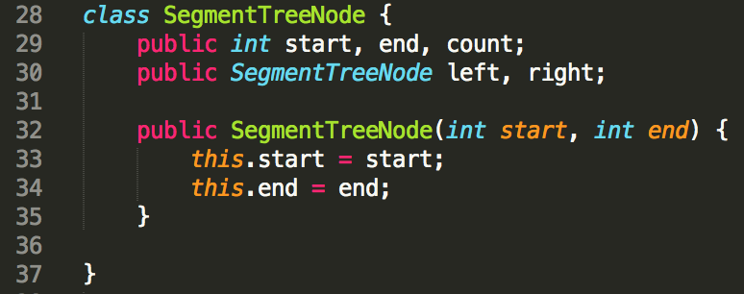
find the number of elements in the in array's interval [start, end]

Slide 30
Given [0, 2, 3]
Y | N | Y | Y
0 | 1 | 2 | 3
[0, 3] (count = 3)
[0, 1] (count = 1)
[2, 3] (count = 2)
[0, 0] (count = 1)
[1, 1] (count = 0)
[2, 2] (count = 1)
[3, 3] (count = 1)
query(root, 1, 1), return 0
query(root, 1, 2), return 1
query(root, 0, 2), return 2

Slide 31
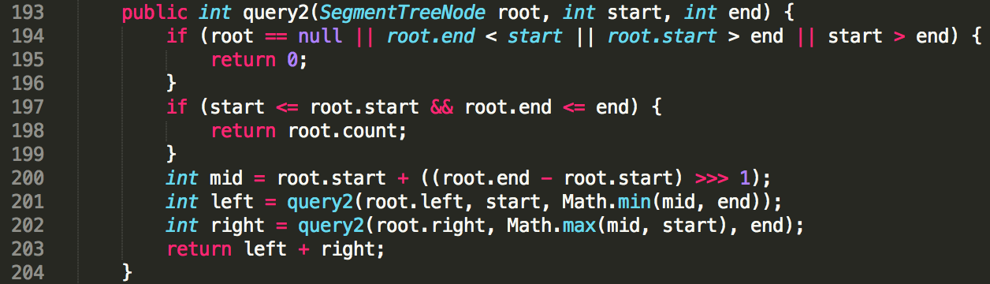

Slide 32
Given [3, 2, 1, 4]
[0, 3] (max = 4)
[0, 1] (max = 3)
[2, 3] (max = 4)
[0, 0] (max = 3)
[1, 1] (max = 2)
[2, 2] (max = 1)
[3, 3] (max = 4)
modify(root, 1, 5)

Slide 33
Given [3, 5, 1, 4]
[0, 3] (max = 5)
[0, 1] (max = 5)
[2, 3] (max = 4)
[0, 0] (max = 3)
[1, 1] (max = 5)
[2, 2] (max = 1)
[3, 3] (max = 4)

Slide 34
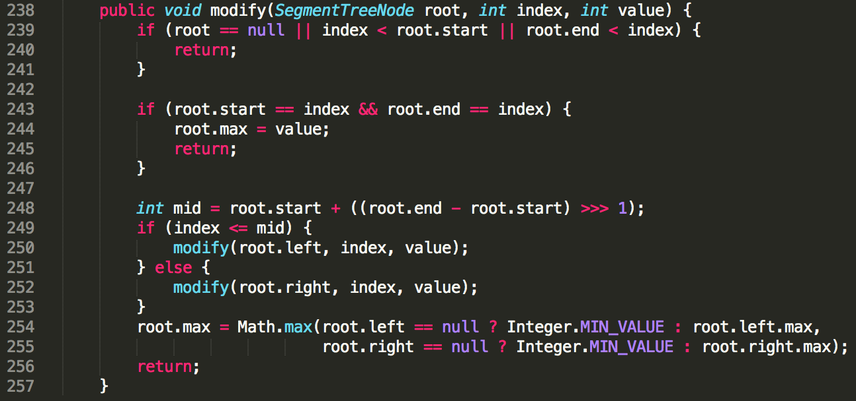

Slide 35
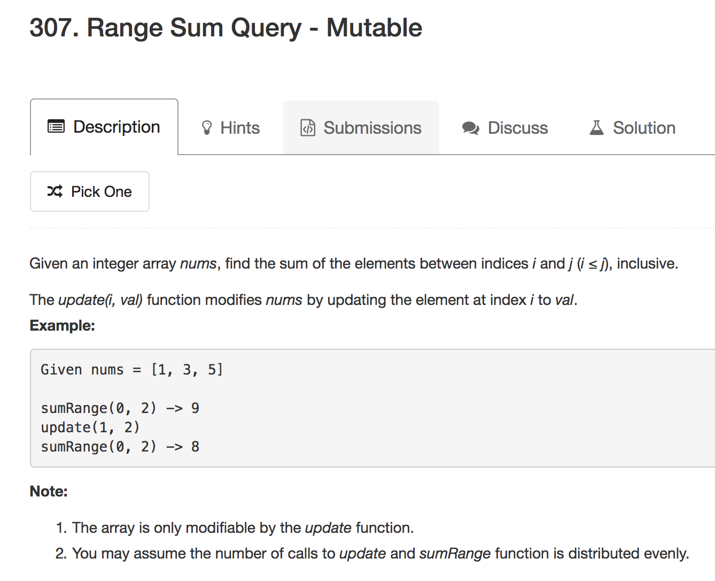

Slide 36
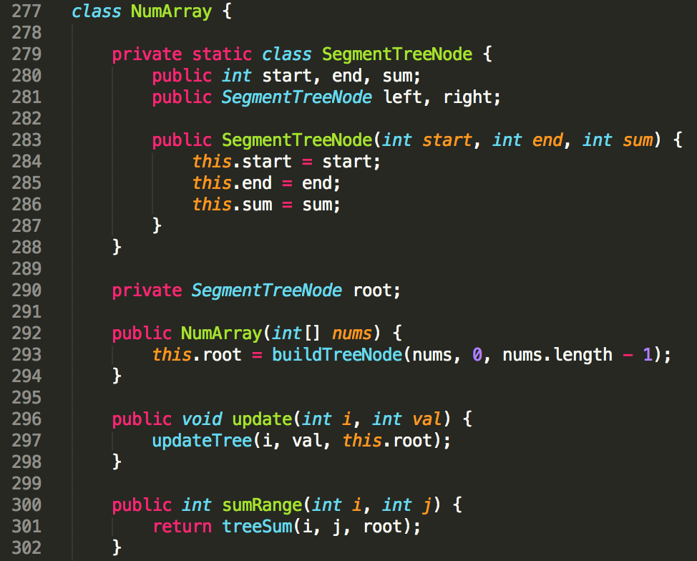

Slide 37
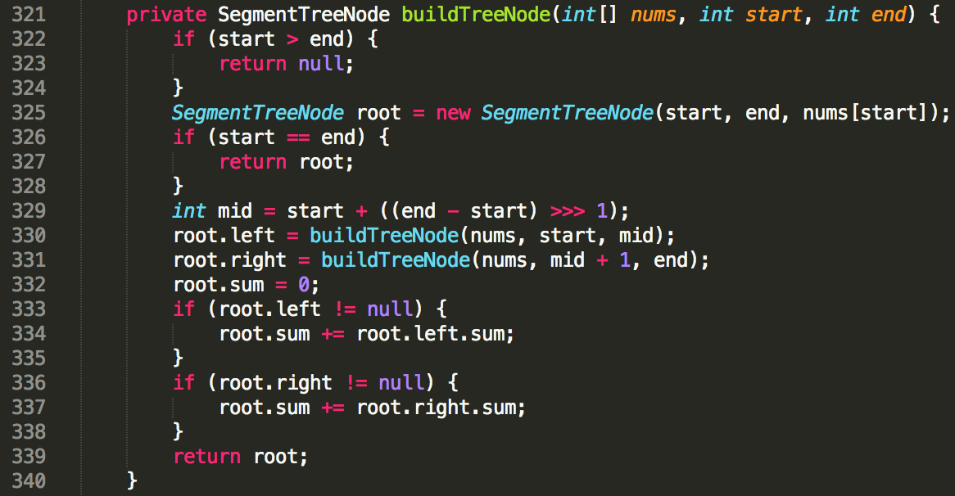

Slide 38
Given nums = [1, 3, 5]
[0, 2] (sum = 9)
[0, 1] (sum = 4)
[2, 2] (sum = 5)
[0, 0] (sum = 1)
[1, 1] (sum = 3)

Slide 39
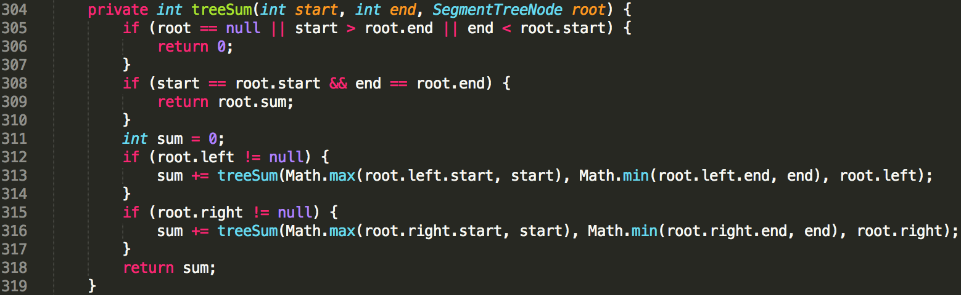

Slide 40
parent
child
start
end
child.left
child.right
[Math.max(child.start, start), Math.min(child.end, end)]

Slide 41
parent
child
start
end
child.left
child.right
[Math.max(child.start, start), Math.min(child.end, end)]

Slide 42
parent
child
start
end
child.left
child.right
[Math.max(child.start, start), Math.min(child.end, end)]

Slide 43
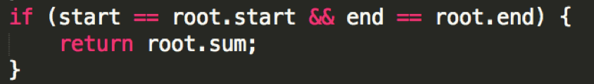
Given nums = [1, 3, 5]
[0, 2] (sum = 9)
[0, 1] (sum = 4)
[2, 2] (sum = 5)
sumRange(0, 2) => 9
[0, 0] (sum = 1)
[1, 1] (sum = 3)

Slide 44
Given nums = [1, 3, 5]
[0, 2] (sum = 9)
[0, 1] (sum = 4)
[2, 2] (sum = 5)
sumRange(1, 2) => 8
[0, 0] (sum = 1)
[1, 1] (sum = 3)

Slide 45
Given nums = [1, 3, 5]
[0, 2] (sum = 9)
[0, 1] (sum = 4)
[2, 2] (sum = 5)
[0, 0] (sum = 1)
[1, 1] (sum = 3)
sumRange(1, 2) => 8
start: 1
end: 2
mid: 1
left: [1, 1 ]
right: [2, 2]

Slide 46
Given nums = [1, 3, 5]
[0, 2] (sum = 9)
left: [1, 1 ]
right: [2, 2]
[0, 1] (sum = 4)
[2, 2] (sum = 5)
[0, 0] (sum = 1)
[1, 1] (sum = 3)
sumRange(1, 2) => 8

Slide 47
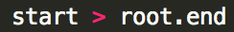
Given nums = [1, 3, 5]
[0, 2] (sum = 9)
5
[0, 1] (sum = 4)
[2, 2] (sum = 5)
left: [1, 0]
right: [1, 1]
[0, 0] (sum = 1)
[1, 1] (sum = 3)
sumRange(1, 2) => 8

Slide 48
Given nums = [1, 3, 5]
[0, 2] (sum = 9)
5
[0, 1] (sum = 4)
[2, 2] (sum = 5)
0
3
[0, 0] (sum = 1)
[1, 1] (sum = 3)
sumRange(1, 2) => 8

Slide 49
Given nums = [1, 3, 5]
[0, 2] (sum = 9)
3
5
[0, 1] (sum = 4)
[2, 2] (sum = 5)
0
[0, 0] (sum = 1)
[1, 1] (sum = 3)
sumRange(1, 2) => 8

Slide 50
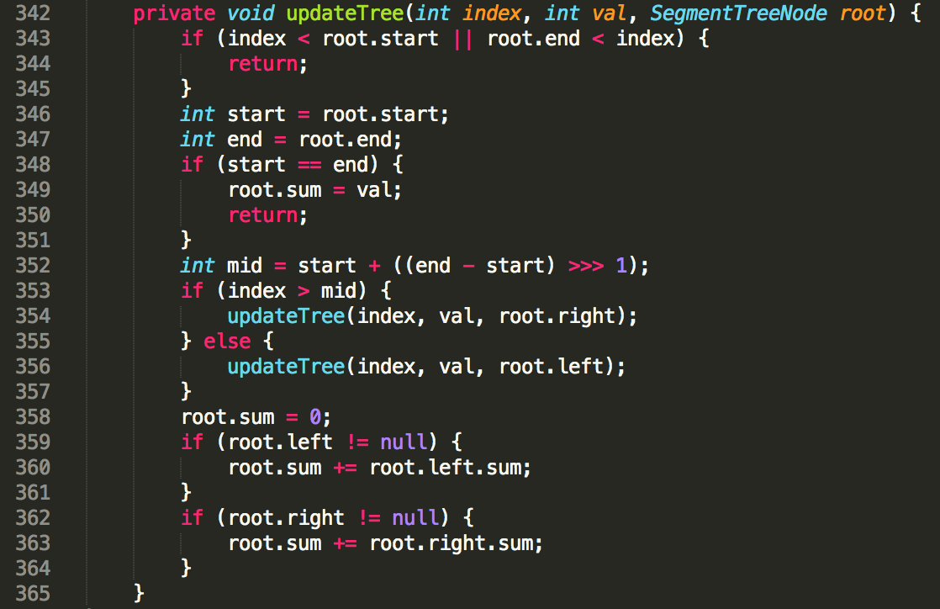

Slide 51
Given nums = [1, 3, 5]
[0, 2] (sum = 9)
[0, 1] (sum = 4)
[2, 2] (sum = 5)
[0, 0] (sum = 1)
[1, 1] (sum = 3)
update(1, 2)

Slide 52
Given nums = [1, 2, 5]
[0, 2] (sum = 9)
[0, 1] (sum = 4)
[2, 2] (sum = 5)
[0, 0] (sum = 1)
[1, 1] (sum = 3)
update(1, 2)

Slide 53
Given nums = [1, 2, 5]
[0, 2] (sum = 9)
[0, 1] (sum = 4)
[2, 2] (sum = 5)
[0, 0] (sum = 1)
[1, 1] (sum = 2)
Bottom Up

Slide 54
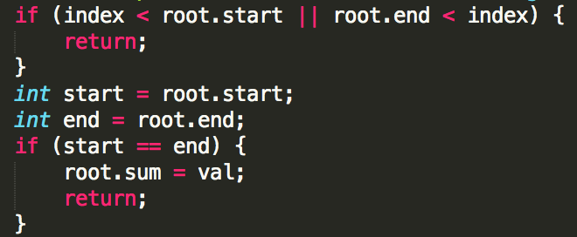
Given nums = [1, 2, 5]
[0, 2] (sum = 9)
[0, 1] (sum = 3)
[2, 2] (sum = 5)
[0, 0] (sum = 1)
[1, 1] (sum = 2)
Base Case

Slide 55
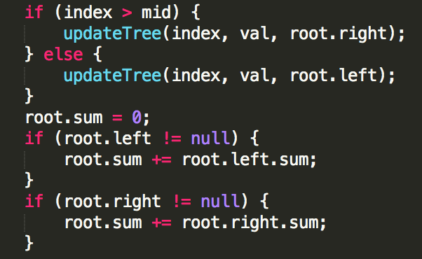
Given nums = [1, 2, 5]
[0, 2] (sum = 8)
[0, 1] (sum = 3)
[2, 2] (sum = 5)
[0, 0] (sum = 1)
[1, 1] (sum = 2)

Slide 56
谷歌经典难题
Given bulb 1, 2, 3, … n. Implement two methods:
void toggle(int rangeBegIndex, int rangeEndIndex)
boolean isOn(int ithBulb)
Segment Tree 的思想
Interval Tree

Slide 57
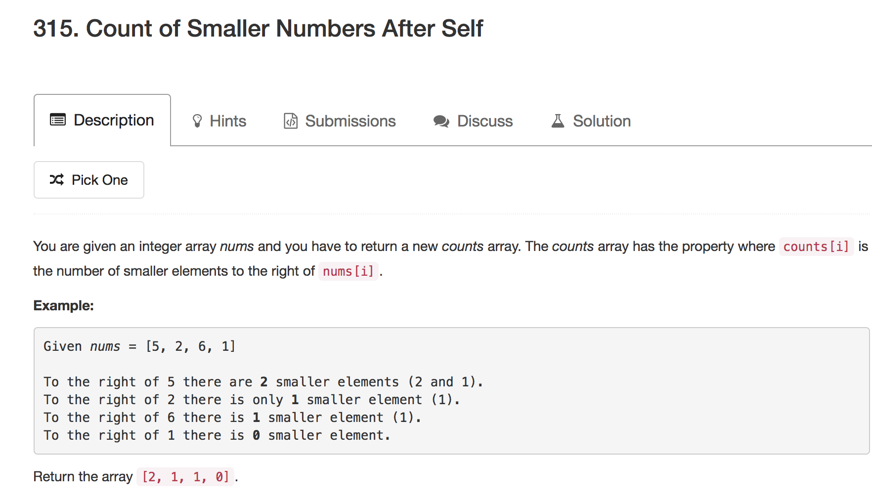
Mock

Slide 58
Xcode Career Service
有任何问题，请咨询 xc0d3@outlook.com

